Slide 1
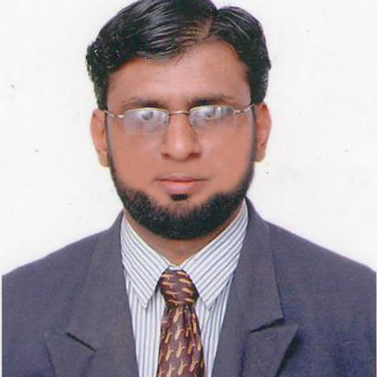



Mohammad Chaus Technical Leader, US BANK
Pune, India
+91-9824886204
Experience and Accomplishments
16+ years of total IT Experience PROFILE KEY HIGHLIGHTS:- DEVOPS MANAGER (ROLE) @ WIPRO | PROJECT PLAN | EFFORT & COST ESTIMATION | DESIGN ARCHITECTURE | IMPLEMENTATION | DELIVERY MANAGEMENT DEVOPS ENGINEERING EXPERIENCE Currently working independently with US Bank customer in migration project from on premise to Azure Cloud Build and enhance CI/CD pipelines using Jenkins, Azure DevOps, GitLab CI Developed & Deployed Java and Spring Boot Maven Microservices in Azure Kubernetes cluster using Helm Charts deployment Deployed microservices in ECS Fargate cluster Deployed applications in AWS (EC2, S3, Lambda, CloudFormation, EKS) Created and successfully deployed Ansible Roles for Automation Integrated SonarQube, SynopSys Scan, Image Build Kaniko using GitLab CI/CD Created IaC pipeline and deployed AZURE & AWS infrastructures such as load balancer, VM, Azure file share, PostGres SQL using Terraform and YAML Hands on experience in using Azure DevOps implementation (Kubernetes cluster, pods, services, ingress and API Management) and Azure Infrastructure Operations AZURE ARCHITECT EXPERIENCE Designed and successfully implemented Azure Architect Solutions to developed in VM based solutions, AKS Orchestration and AutoSys Solutions Provide technical leadership to development teams, guiding them in choosing the right Azure services and components Experience in designing architecture and high level & low level design document Regularly review and optimized cloud resource utilization to ensure cost effectiveness solutions PROJECT MANAGEMENT EXPERIENCE Hands on Experience in SOW Management Developed Comprehensive Project Plan Monitored project progress through regular status Meetings, Progress Reports, And Performance Metrics Business Requirement Gathering and Scoping (JIRA/Azure Board/Confluence) Ensuring the regular delivery of projects with Agile/Scrum methodologies Experience in performing analysis, consulting, and providing recommendations to clients
.NET EXPERIENCE Hands on Experience in Microsoft Skills such as .NET, C#, SQL SERVER, MVC Experience in design patterns such as Singleton, Abstract Factory and SOLID principles
Certified & Experienced DevOps Manager with 16+ years in CI/CD pipeline automation, Kubernetes and cloud computing (Azure/AWS). Proven expertise in optimizing infrastructure, reducing deployment time, and leading cross-functional DevOps teams to ensure seamless software delivery. Passionate about cloud automation, security, and scaling enterprise applications.
Roles Played Azure Architect Senior DevOps Engineer Project Manager .NET Developer | Areas of Expertise CI/CD Automation DevOps Engineering Azure Architect | Skills Azure DevOps AWS ECS Fargate AKS Orchestration AWS (EC2, S2, Lambda, EKS) GitLab Jenkins Terraform ASP.NET C# MVC SQL Server
 | Industry Sectors Banking Insurance Healthcare Supply Chain
Consulting Engagements US Bank Forward Air National General Insurance System Microsoft Novartis Outset Medical | Education/Certifications Doctorate in Business Administration, GGU, CA-USA. BE (Computer Science), VTU, Bangalore Cisco Certified Network Associate PMP Certified Professional Azure Fundamentals, Microsoft

